Slide 1
Mortgage Payback Analytics for ABC bank
By-
Deepshi Sachan

Slide 2

Business Goal
Identify whether loan borrower will payback their loan or will default.
Business wants to find if customer is defaulting on loan, then at what time (i.e., time percentage) they will default- early or later stage.
Identify helpful pattern and factors that determine if a customer will pay off the loan or will default.

Slide 3
Analytical Approach
By creating two predictive models.
Create a classification model to classify loan borrower as Defaulter or Not.
Status time – Outcome variable
Create a regression model to predict the time at which customer are defaulting on loan.
time percentage – Outcome Variable
Utilizing k-means clustering method, to determine what are the different combination of customer financial features that will segment them into categories of defaulter, or payoff.
2. Identify customer as defaulter or not
3. If defaulted,
4. At what time will they default.
Take action on early-stage customer to reduce risk.
1. Apply these models on new customer.

Slide 4
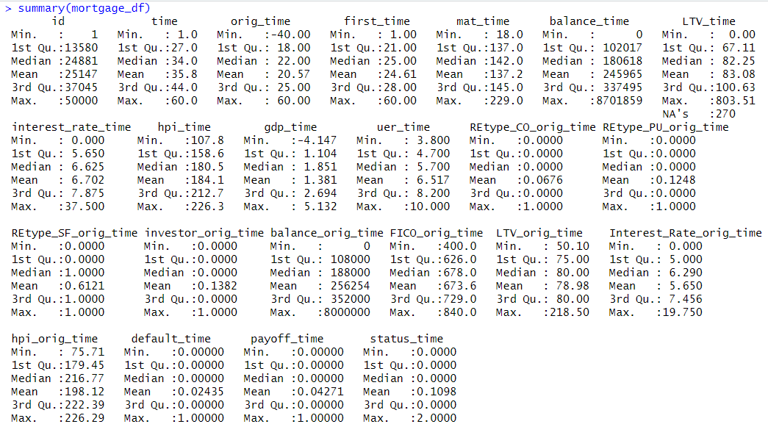
Data Exploration
Dataset contain 50,000 customer information on mortgage loan and 23 variables.
Missing values were handled.
No multicollinearity.
Dimension reduction is not required.

Slide 5
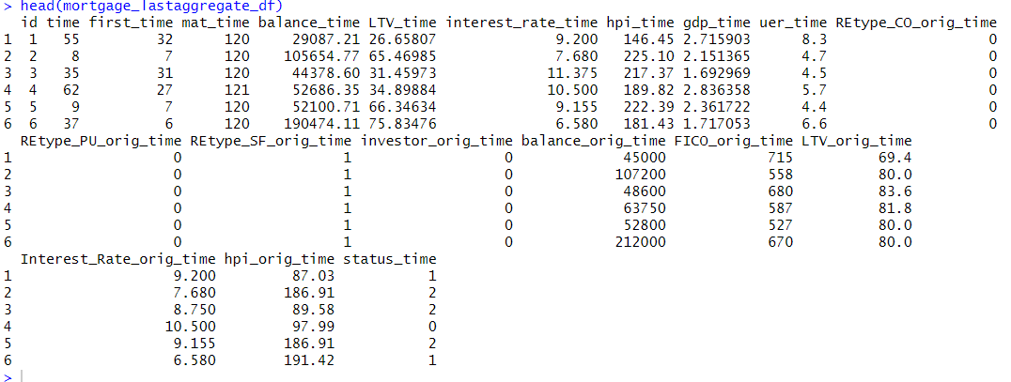
Data Preparation
Updated time and aggregated the data by grouping each borrower id into single record.

Slide 6


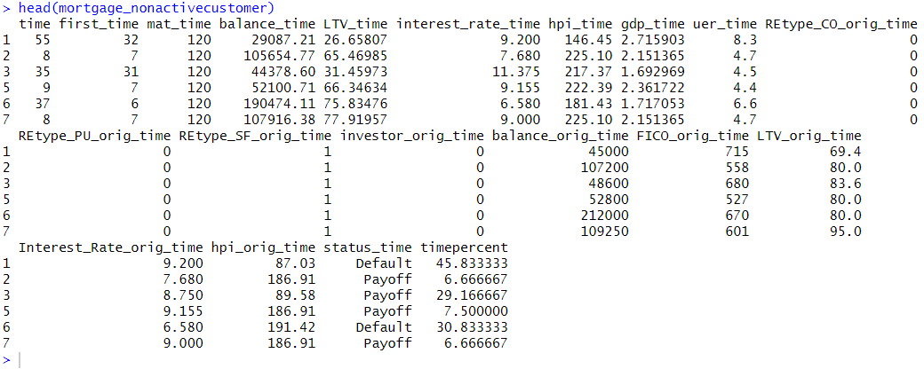
Data Preparation
Loan Borrower
Active Customer
Non-active Customer
Train
Created new variable- time percentage:
time% = time/loan length

Slide 7
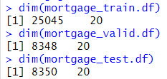
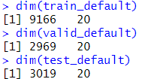
Data Partition
Training
60%
Validation
20%
Holdout
20%
For Classification model
Use whole dataset of non-active customer
For regression model
Use a subset of non-active customer who defaulted on loan. (Status_time = Default)

Slide 8
Classification
To classify whether a loan borrower will pay off the loan or will default.
Outcome Variable: Status_time.
Important class = Pay off
For Classification Model
On Validation set | Accuracy | Sensitivity | Specificity
Logistic Regression | 0.7784 | 0.8721 | 0.6086
Classification Tree | 0.7726 | 0.8353 | 0.6591
Random Forest | 0.7979 | 0.8648 | 0.6767
Classification | Accuracy | Sensitivity | Specificity
Random Forest | 0.8068 | 0.8738 | 0.6886

Slide 9
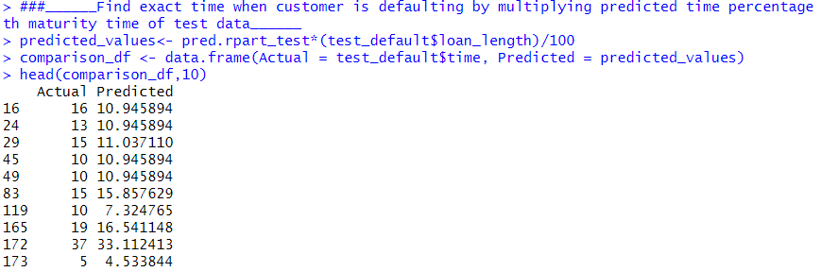
Regression
On validation set
On Validation set | MAE | RMSE
Linear Regression | 3.62467 | 5.68673
Stepwise Backward | 3.623914 | 5.6872
Regression Tree | 2.441736 | 4.0169
To predict if customer defaulted on the loan, then at what time will they default on loan.
Outcome Variable: Time percentage
On Holdout Set | MAE | RMSE
Regression Tree | 2.41322 | 4.28059

Slide 10
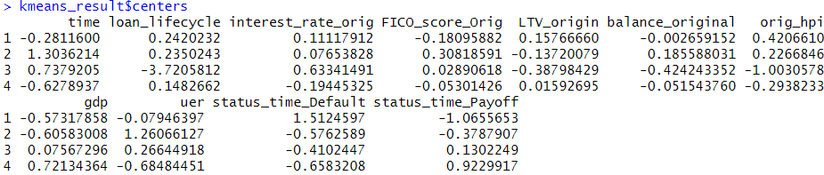
K-means Clustering
To Identify helpful pattern and factors that determine if a customer will pay off the loan or will default.
Notes:
Cluster 1- LTV was high and low gdp value. Higher LTV suggest that customer has less equity and loan is risky.
2- No such observation found. Unemployment rate is high, gdp of a country is low.
3- Customer who might pay off the loan has low hpi index at origin, low LTV ratio, medium gdp.
4- Customer who will payoff the loan as their country gdp is high, has low unemployment rate and it shows that customer will payoff the loan.
A lower LTV ratio is better in the eyes of lenders because it means the borrower has more equity in the property and the loan is less risky.

Slide 11
Performing further k-means clustering to identify- “what factors lead customer to default on loan”
Cluster 1 tells those customers whose balance loan at origin is high and unemployment rate is little higher while GDP is low then a customer can default.
Cluster 2 tells if unemployment rate is high and GDP is low, and if customer is using this property for investment purpose, then customer can default on loan.
Cluster 3 shows that even though GDP is high, and balance is low but if fico score of the loan borrower is low and house price index is low then customers might default on loan as the overall credit score is low and price of the house is not high in the market.
Cluster 4 shows that when interest rates at origin is high even though if gdp is high, chances of customer defaulting on loan will rise.
Cluster 5 shows if LTV at origin is high which suggests that customer has less equity that means loan is risky.

Slide 12
Thank You

